Slide 1

Progress of Women and People of Color in Professional and Management Positions, 2010 - 2030
Ravi Chinnamanaidu, Ashni Dattani, Michal Fineman, Alexandra Zelcer 9/18/2020
Notes:
Our team set out to examine data from the Bureau of Labor Statistics regarding employment of women and People of Color in higher level positions. We wanted to see how these populations were represented in professional and managerial jobs and how that representation had changed over the last ten years, how we could expect it to change in the next ten or eleven years, and whether we could figure out any of the factors that might affect that rate of change.
A disclaimer before we start: by the nature of the inquiry, we are dealing with percentages rather than raw numbers. As we’ve learned in the course of the project, there are actually some differences in how percentages rather than raw numbers need to be dealt with statistically. We’ve gone ahead and used the methods we know from this course, but they might not hold up to scrutiny in the real world.

Slide 2
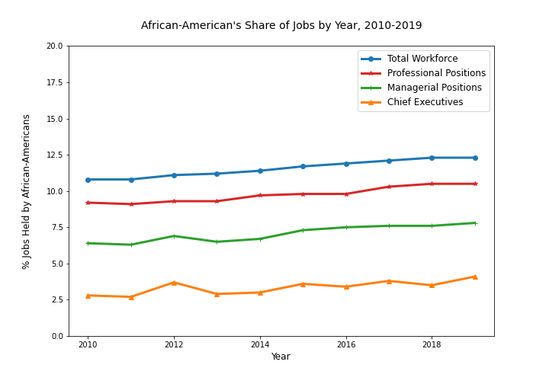
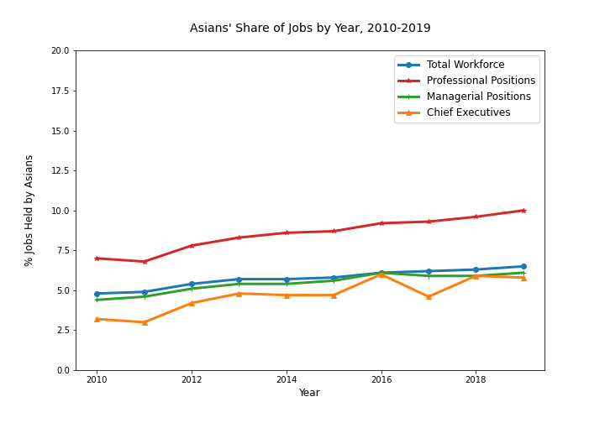
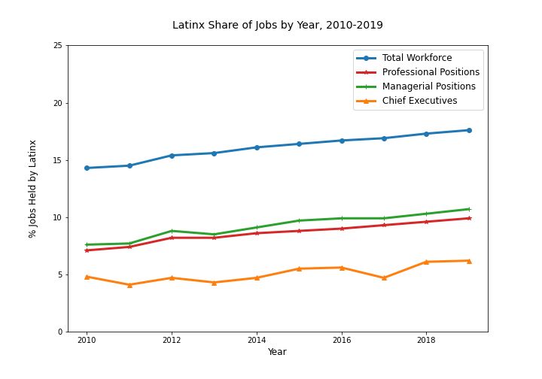
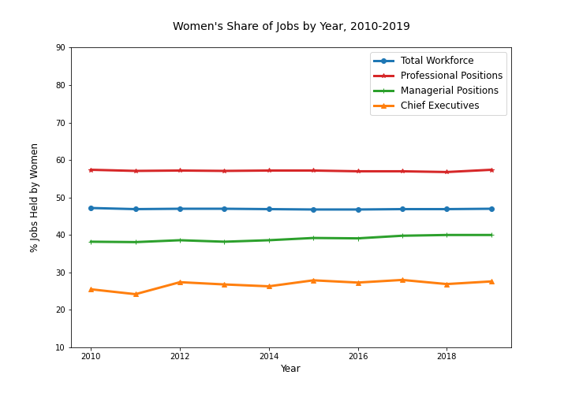
Representation Over Past Ten Years
Notes:
So..these charts show each population group’s share of jobs in the total workforce and their share of professional, managerial, and chief executive positions. Over the past ten years representation of African-americans, latinx, and Asians has generally gone up at least slightly, while movement among women has been flatter. But the real story is between the lines—literally, the space between the lines. For example, we can see that latinx workers’ share of managerial and professional jobs has gone up in the past ten years. But so has their share of the workforce as a whole. If all things were truly equal, we would expect that latinx workers would be represented in managerial ranks in the same proportion as they are in the workforce but there ‘s a big gap between those two lines, so clearly they’re not.

Slide 3
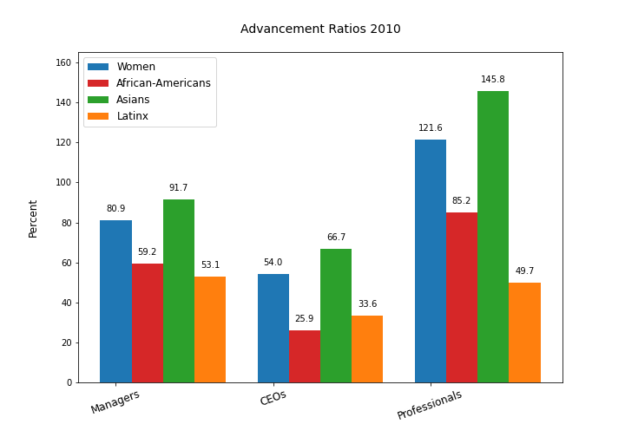
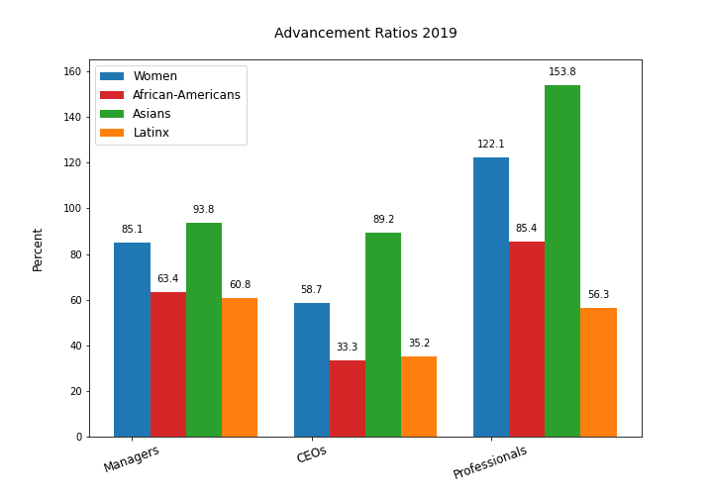
Advancement Ratios
Notes:
So, we looked at what we’re calling advancement ratios—the comparison of share of a particular job category, like managers or professionals, to the population group’s share of the total workforce. If a group’s share of a job category is at parity with their share of the workforce, the ratio is 100%. These charts for advancement ratios in 2010 and for ten years later show that, with a few exceptions, women and people of color hold higher level jobs at considerably lower levels than their share of the workforce.

Slide 4
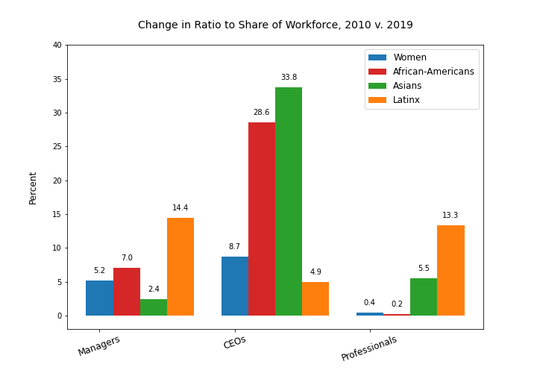
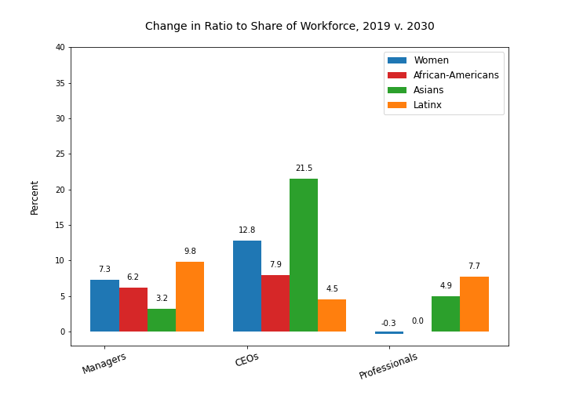
Change in Advancement Ratios 2010 to 2030
Notes:
To see how much the gap has closed during the past ten years, we charted the change in advancement ratio from 2010 to 2019. We were also interested to see what the future would look like if these trends continued so we ran linear regression analyses to predict what representation of each group would be in 2030 and then calculated the advancement ratios and expected change between now and then, which is what you’re seeing on the right. Now, another thing we’ve learned this week is that linear regression is not the best method to use in predicting change over time, because the data for one year is dependent on the data from the previous year, so each year is not really an independent variable. Nevertheless, since we haven’t yet learned how to do time series, for the purposes of the exercise we plunged forward:
Our model predicts slower progress in a number of categories over the next 11 years than in the past ten. Assuming, then, that—as these charts suggest—progress of women and some people of color into higher level positions is slowing, we wanted to know what would need to change in order to speed it up.

Slide 5
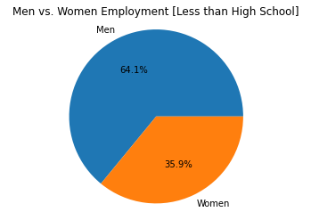
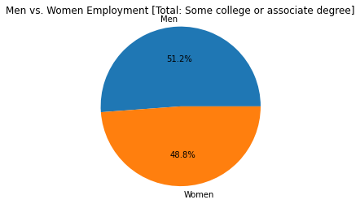
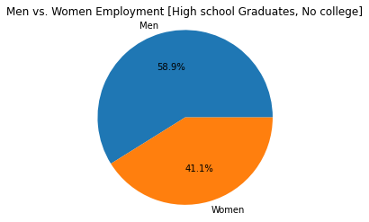
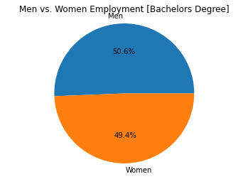
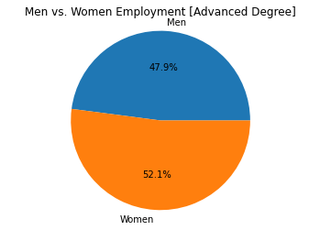
Education levels for Male & Female workers, 2019
Notes:
One thing we looked at was education. We don’t have data on the education level of people who hold professional and managerial jobs, but we do know, as illustrated here, that women in the workforce are just about as likely as men to hold bachelor’s degrees and more likely than men to hold advanced degrees. While 47% of the workforce are women, 49% of those holding bachelors degrees are women and 52.1% of workers with advanced degrees are women.

Slide 6
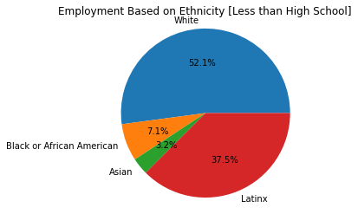
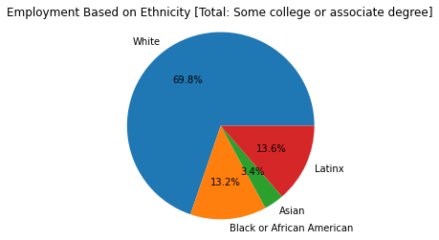
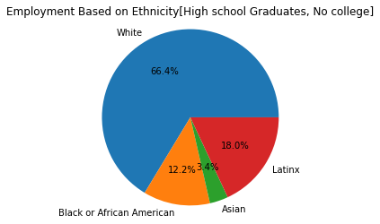
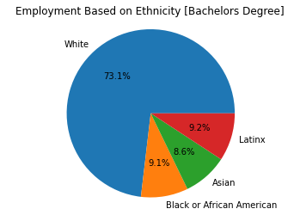
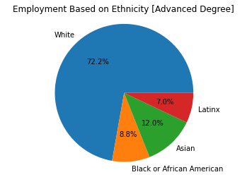
Education Levels for POC, 2019
Notes:
On the other hand, you can see that white workers’ share of educational credentials increases as you go up in education level, while that of African-Americans and Latinx decreases. We know from our previous slides that, on the whole, the share of jobs for people of these ethnicities also decreases as you go up the ladder. We cannot say that this phenomenon is correlated with the numbers of poc in higher level jobs, but it is perhaps an area that should be studied in greater detail.

Slide 7
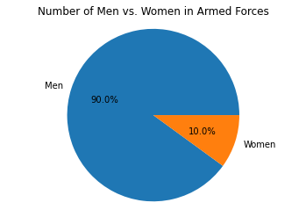
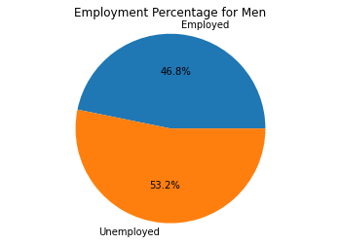
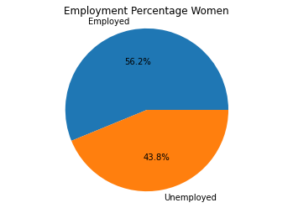
Veteran Status, Men v. Women, 2019
Total Veteran men, 18 years and over employed in the Civilian Labor Force: 7.9MM
Total Veteran women, 18 years and over employed in the Civilian Labor Force: 1.6MM
Notes:
We were curious about whether service in the armed services might have some correlation with access to higher level jobs. Unfortunately, our data source could only tell us about the proportion of male and female veterans who are now employed in civilian jobs –women veterans are more likely to be employed than male veterans, but that could be due to any number of factors. In any case, the effect of military service on later career advancement would be an interesting topic for further investigation.
These graphs show the percent of the Civilian Noninstitutional Population that is employed in the Civil labor force, for men and women.
There are a considerably more men in the armed forces compared to women so even though there is a higher percentage of unemployment for men, there are still many more veteran men who are employed in the Civil Labor Force than women.

Slide 8
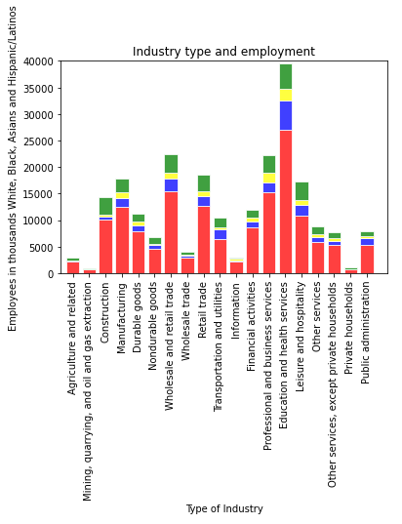
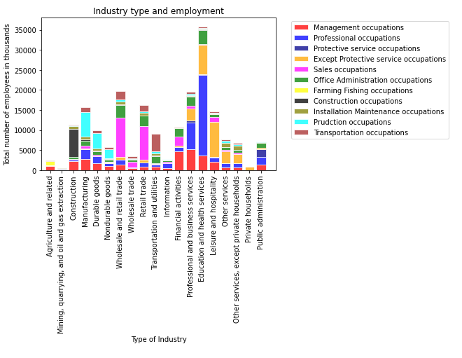
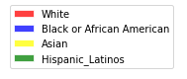
Employment of POC by Industry and Occupation
Notes:
Another possibility is that the industries where women and people of color work might provide more or less opportunity for advancement. We were able to get data on the number of professional and managerial jobs in various industries. Setting that side by side with the numbers of people of color in those industries raises more questions than it answers. The industries with highest concentration of people of color are transportation and utilities and wholesale and retail trade. These also happen to be industries with relatively few managerial and professional opportunities.

Slide 9
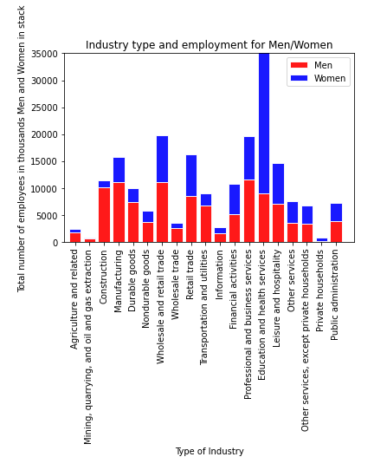
Employment of Women and Men by Industry and Occupation
Notes:
Women’s concentration in the education and health sector is especially noteable. That is an industry where professional jobs predominate, and you may recall that women are over represented in the professional category. However, women are also heavily represented in leisure and wholesale and retail industries, where there are fewer professional and managerial opportunities. So, any correlation is for now unclear.

Slide 10
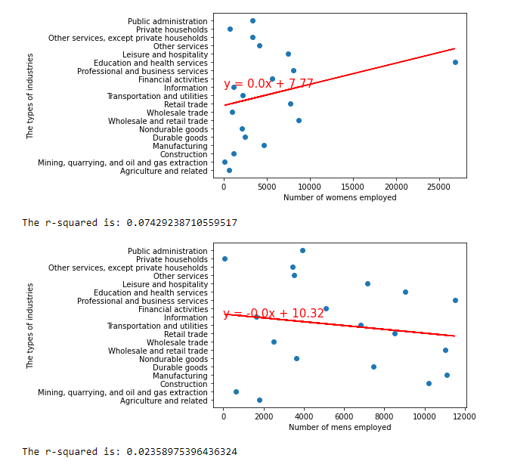
Employment of Women and Men by Industry and Occupation

